Slide 1


mws Partner Education

Slide 2
Business Start-Up
The Entrepreneur Series

Slide 3

Our Journey Together
Business
Plans
The Entrepreneur
Managing Finances
Starting
Up
Research, Select & Decide

Slide 4

The Entrepreneur

Slide 5

Making an Impact

Slide 6
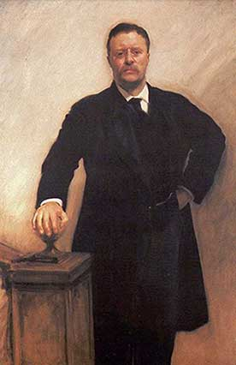
‘It is not the critic who counts: not the man who points out how the strong man stumbles or where the doer of deeds could have done better. The credit belongs to the man who is actually in the arena, whose face is marred by dust and sweat and blood, who strives valiantly, who errs and comes up short again and again, because there is no effort without error or shortcoming, but who knows the great enthusiasms, the great devotions, who spends himself for a worthy cause; who, at the best, knows, in the end, the triumph of high achievement, and who, at the worst, if he fails, at least he fails while daring greatly, so that his place shall never be with those cold and timid souls who knew neither victory nor defeat.’
:Teddy Roosevelt from a speech in 1910

Slide 7

Definition
An entrepreneur is a person who undertakes
the creation of an enterprise or business
that has the chance of profit (or success).
An individual who creates a new business
in the face of uncertainty
for the purpose of achieving profit and growth
by identifying and capitalizing opportunities
and assembling the necessary resources
to capitalized on the identified opportunities.

Slide 8

What’s the difference?
Functions | Managers | Petty Traders | Entrepreneurs
Assuming Ownership | ❒ |  | 
Assuming Leadership |  |  | 
Assembling Resources |  |  | 
Forming New Ventures | ❒ |  | 
Expanding opportunistically |  | ❒ | 
Drive and Motivation | Subservient to corporate directives | Self employment and Family | Self fulfilment and self actualization

Slide 9
Characteristics
Not Entrepreneurs | Bad Entrepreneurs | Good Entrepreneurs
Are very cautious –never want to take any risks | Ignore risks –assume their own charisma/skill guarantee success | Take calculated risks – weighing potential risks & resources
Assume that things are the way it have to be | Rush to bring in something new or made huge changes without proper market study | Launch new ideas and marketing approach in response to client’s tastes & attitudes
Like to be sure of the next month’s salary – and the one after…………. until retirement……….. perhaps even the pension!!!!!!! | Trust that things will go as planned, spend freely at the start as they are sure of cash will start flowing tomorrow | Accept that the early days of a new business may be tough, so try to spend as little as possible

Slide 10

The Entrepreneur

Slide 11

Why Do You Want to Start Biz?
Achievement
Money
Contribution
Family
Legacy

Slide 12

How can I Plan for This?
Exit Strategy

Slide 13

Do You Have What it Takes?
Notes:
Fill up the Questionnaires and discuss the result.

Slide 14

Basic Competencies
The Competency Clusters

Slide 15

Taking Risks
Financial
Family Time
Fear of Failure
Fear of being Different
Fear of Rejection
What Are You Risking?

Slide 16

What’s Great About Starting Your Own Business?
What Do You Want?

Slide 17




Case Study
Industry: Corporate Training, Learning & Development

Slide 18

What Have You Learnt?
What are 3 key distinctions you have learnt?
How does that empowers you to start your business?
What steps/actions would you take to ensure success?
Thank You

Slide 19

Workforce Learning Solution
Notes:
19

Slide 20





miniworkshopseries.com
Thank You

Slide 21

mws Partner Education

Slide 22
Business Start-Up
The Entrepreneur Series

Slide 23
Our Journey Together
Business
Plans
The Entrepreneur
Managing Finances
Starting
Up
Research, Select & Decide

Slide 24
Research, Select & Decide

Slide 25

Types of Business
Customer type
Customer volume
Reason for purchase
Buyer behaviour
Types of order
Purchasing Authorization
Buying process
Payment terms
Means
Relationship
Products and Services
Can You Decide?

Slide 26

Forms of Business Entities
Sole Proprietor
Partnership
Private Limited

Slide 27
Choosing Wisely
Timely
Solvable
Important
Profitable
Favorable Context
Enjoys the work
Loves the
challenge
Do whatever
it takes
The Sweet
Spot
Experience
Knowledge
Skills
Financial abilities
Networking

Slide 28

The First 6 Steps
Recognizing clients needs and wants
1
Industry, Demographics, Purchasing Power, Motives, Buying Habits
Analyzing & scanning environment
2
Regulatory, Trends, Media and Internet
Evaluating self: Assessing own self
3
KSA, Experience, Interests, Financial
& Networking Abilities
Screening & choosing of biz opportunities
4
Competition, Legality, Capital Requirements, Risks
Matching values, and acceptance
5
Values, Perception, Social
Acceptance
Preparing & constructing a biz plan
6
Admin, Operation, Marketing, Financial, Implementation

Slide 29
Select Opportunities
Time for some Answers

Slide 30
Case Study
Industry: Corporate Training, Learning & Development

Slide 31
Your Business model
Customer Selection
Value Proposition
Differentiation and Control
Scope of Product and Activities
Organizational Design
Value Capture for Profit
Value for Talent

Slide 32
What Have You Learnt?
What are 3 key distinctions you have learnt?
How does that empowers you to start your business?
What steps/actions would you take to ensure success?
Thank You

Slide 33
Workforce Learning Solution
Notes:
33

Slide 34
miniworkshopseries.com
Thank You

Slide 35
mws Partner Education

Slide 36
Business Start-Up
The Entrepreneur Series

Slide 37
Our Journey Together
Business
Plans
The Entrepreneur
Managing Finances
Starting
Up
Research, Select & Decide

Slide 38
Starting Up

Slide 39
Things To Do
Register Your Company [ROB/ROC]
Venue of business operations
Open a Current Account
Register [depending on your country]
  Internal Revenue Board [IRB]
  Employee Provident Fund [EPF]
  SOCSO
Appoint Accountant / Auditors / Co-Sect

Slide 40
Things to Do
Registering Utilities [Phone/Fax/Internet]
Buy Internet Domain
Print Name Cards / stationeries
Write Business Profile
Start Employing

Slide 41
Our Journey Together
Business
Plans
The Entrepreneur
Managing Finances
Starting
Up
Research, Select & Decide

Slide 42
Managing Finances

Slide 43

Using the Templates

Slide 44

$tart Up Budget
Facilities
Office Equipment
Materials and Supplies
Other Costs
What do You need to get Started?

Slide 45

Performa P&L
Revenue
Expenses
Product Lines
Best case
Worst case
Likely case
Monthly Fixed
Variable
Business Viability

Slide 46
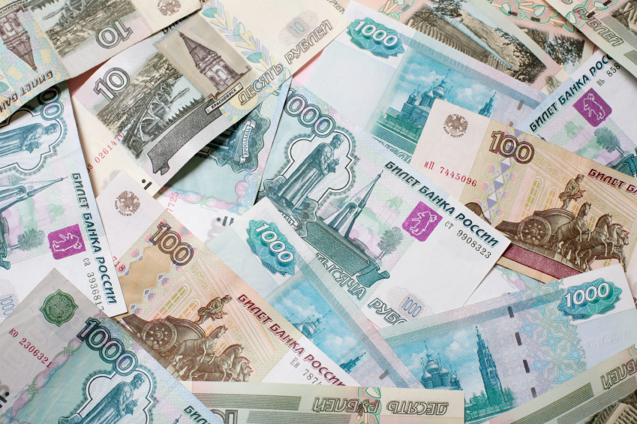

Working Capital Required

Slide 47
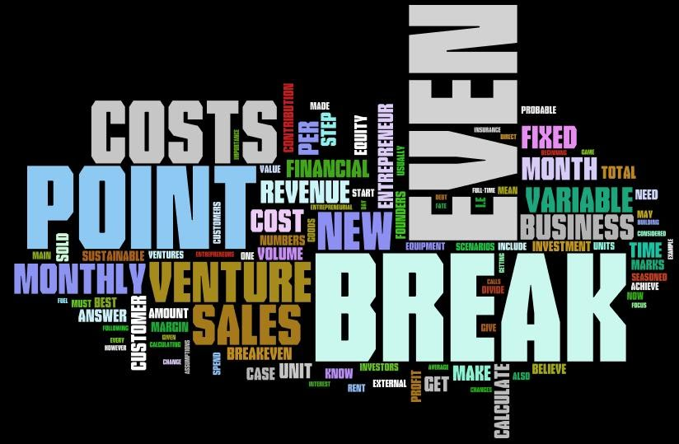
Your Breakeven Point
Benchmark For Cost Savings & Expansion

Slide 48
What Have You Learnt?
What are 3 key distinctions you have learnt?
How does that empowers you to start your business?
What steps/actions would you take to ensure success?
Thank You

Slide 49
Workforce Learning Solution
Notes:
49

Slide 50
miniworkshopseries.com
Thank You

Slide 51
mws Partner Education

Slide 52
Business Start-Up
The Entrepreneur Series

Slide 53
Our Journey Together
Business
Plans
The Entrepreneur
Managing Finances
Starting
Up
Research, Select & Decide

Slide 54
Business Plans

Slide 55
Our Journey Together
Business
Plans
The Entrepreneur
Managing Finances
Starting
Up
Research, Select & Decide

Slide 56

The single most important task
Your Business Plan is your blueprint for success

Slide 57

The Blueprint
3 Main Sections
  Executive Summary
  Main Body
  Conclusions

Slide 58

Executive Summary
Captures the Essence : Why?
  Depend on Purpose: Loan/ Investment / etc
Key Ideas, differentiation, ROI, etc
Write it last
Keep to one page
[if possible, max 2pages]

Slide 59

Unique Selling Proposition
Differentiation Factor
What makes you different from your competitors?

Slide 60

Business Plans
Executive Summary
Introduction
Purpose
Company Background
Ownership / Mgmt
Administrative Plan
Marketing Plan
Operations Plan
Financial Plan
Conclusion

Slide 61

Write Your Business Plan

Slide 62

The Heart of Any Business
Sales

Slide 63

Expand Your Network
Tell
Tweet
Blog
FB
Leverage
Skills
Present
Web
Customer is King
Network
Elevator Pitch

Slide 64

Do Well By Doing Good
Trust
Honesty
Ethics
Values
Integrity
Purpose
Be Responsible to Stakeholders

Slide 65
What Have You Learnt?
What are 3 key distinctions you have learnt?
How does that empowers you to start your business?
What steps/actions would you take to ensure success?
Thank You

Slide 66
Workforce Learning Solution
Notes:
66

Slide 67
miniworkshopseries.com
Thank You

